Slide 1


Scientific Machine Learning
Lecture 2: Regression (Part I)
孟旭辉
数学与统计学院数学与应用学科交叉创新研究院
办公室：欣苑2栋111室
Email：xuhui_meng@hust.edu.cn
3/8/2024

Slide 2
Contents
Deep Neural Networks
Optimization – (Stochastic) Gradient descent algorithm
One-dimensional Function Approximation

Slide 3
Contents
Deep Neural Networks
Optimization – (Stochastic) Gradient descent algorithm
One-dimensional Function Approximation

Slide 4

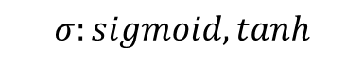
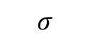
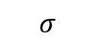
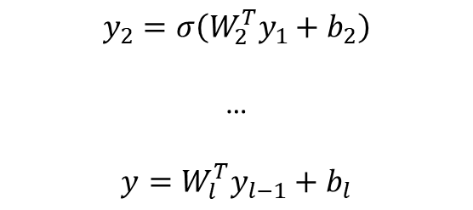
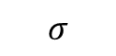
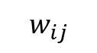

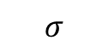

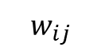
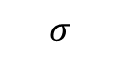
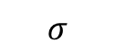
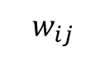
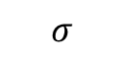
Deep Neural Networks (DNNs): Universal Approximation Theorem
$$w_{ij}$$
$$w_{ij}$$
$$σ$$
$$σ$$
$$y_{1}=σ(W_{1}^{T}x+b_{1})$$
$$w_{ij}$$
$$σ$$
$$σ$$
$$y_{2}=σ\left(W_{2}^{T}y_{1}+b_{2}\right)$$
…
$$y=W_{l}^{T}y_{l−1}+b_{l}$$
y
$$σ$$
$$σ$$
$$σ$$
$$σ$$
$$σ:sigmoid, tanh$$
Standard multilayer feedforward networks are capable of approximating any measurable function to any desired degree of accuracy
Convergence rate increases as the number of hidden units grows
K. Hornik, etc, Neural Networks, 1989

Slide 5
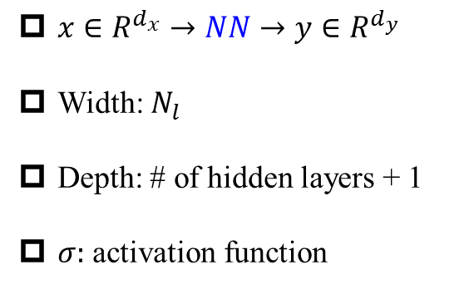
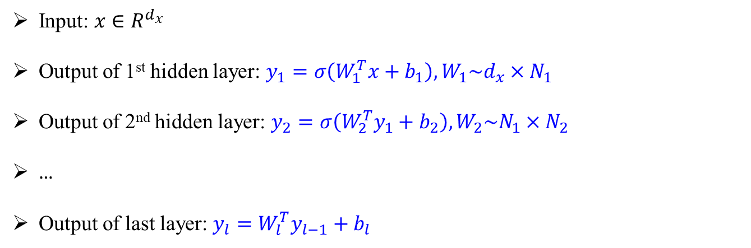
Deep Neural Networks (DNNs): Universal Approximation Theorem
$$w_{ij}$$
$$w_{ij}$$
$$σ$$
$$σ$$
$x∈R^{d_{x}}→NN→y∈R^{d_{y}}$
Width: $N_{l}$
Depth: # of hidden layers + 1
$σ:$ activation function
$$w_{ij}$$
$$σ$$
$$σ$$
y
$$σ$$
$$σ$$
$$σ$$
$$σ$$
Input: $x∈R^{d_{x}}$
Output of 1st hidden layer: $y_{1}=σ\left(W_{1}^{T}x+b_{1}\right), W_{1}\sim d_{x}×N_{1}$
Output of 2nd hidden layer: $y_{2}=σ\left(W_{2}^{T}y_{1}+b_{2}\right),W_{2}\sim N_{1}×N_{2}$
…
Output of last layer: $y_{l}=W_{l}^{T}y_{l−1}+b_{l}$
Hornik, et al, Neural Networks, 1989

Slide 6

DNNs: About activation functions
Remarks:
First choice: tanh
For very deep NNs, try ReLu-type activation function first

Slide 7
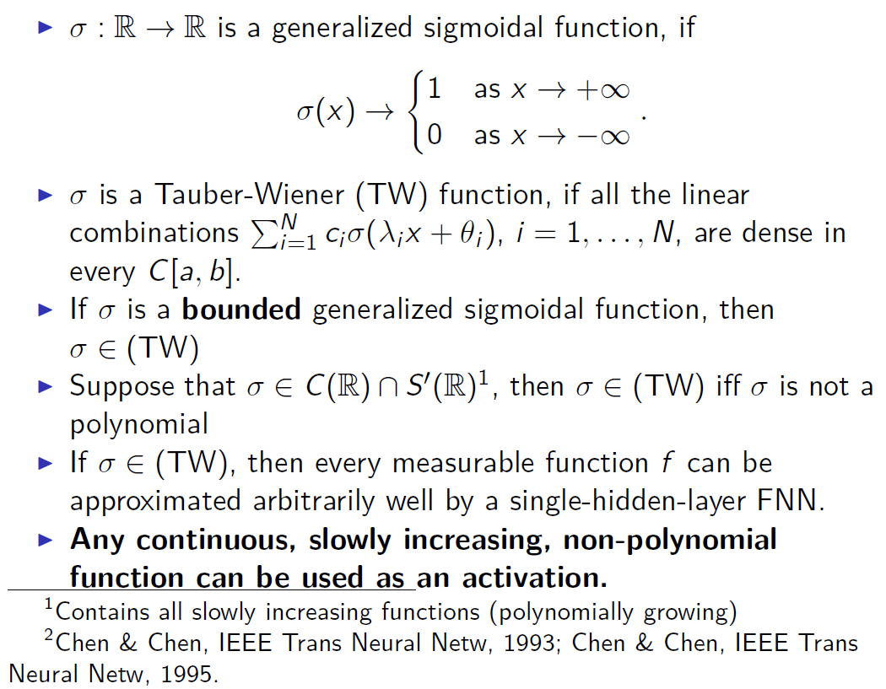
DNNs: About activation function

Slide 8
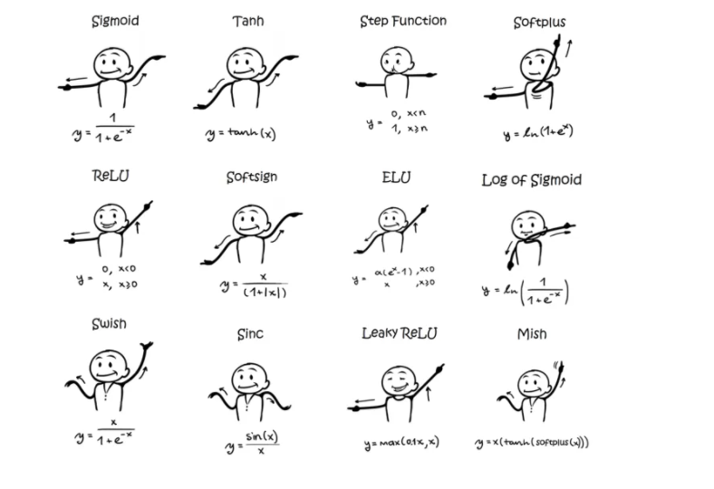
DNNs: About activation functions

Slide 9
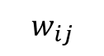
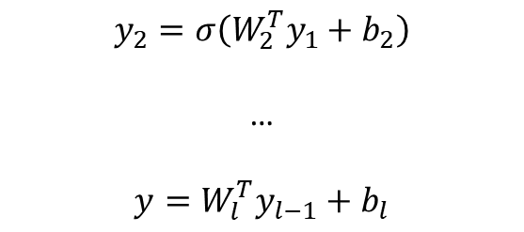
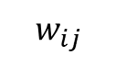
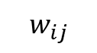
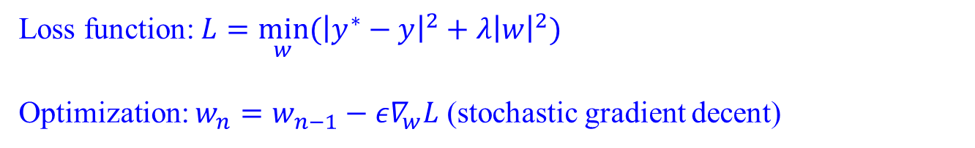
DNNs: Optimization
$$w_{ij}$$
$$w_{ij}$$
$$σ$$
$$σ$$
$$w_{ij}$$
$$y_{1}=σ(W_{1}^{T}x+b_{1})$$
$$σ$$
$$σ$$
$$y_{2}=σ\left(W_{2}^{T}y_{1}+b_{2}\right)$$
…
$$y=W_{l}^{T}y_{l−1}+b_{l}$$
y
$$σ$$
$$σ$$
$$σ$$
$$σ$$
$$σ:sigmoid, tanh$$
Standard multilayer feedforward networks are capable of approximating any measurable function to any desired degree of accuracy
Convergence rate increases as the number of hidden units grows
Loss function: $L={\min_{w}⁡(\left|y^{∗}−y\right|}^{2}+λ{\left|w\right|}^{2})$
Optimization: $w_{n}=w_{n−1}−{ε∇}_{w}L$ (stochastic gradient decent)
Hornik, et al, Neural Networks, 1989

Slide 10
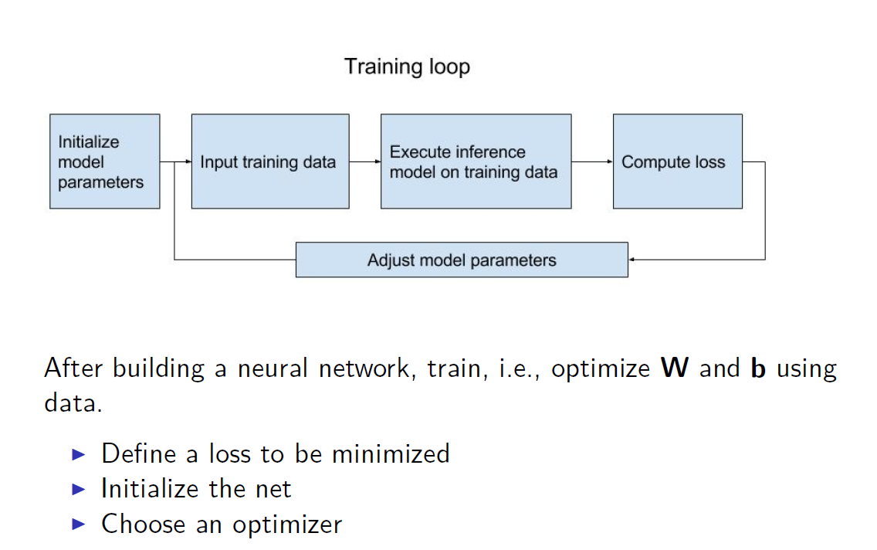
NN for regression problems

Slide 11
Contents
Deep Neural Networks
Optimization – (Stochastic) Gradient descent algorithm
One-dimensional Function Approximation

Slide 12
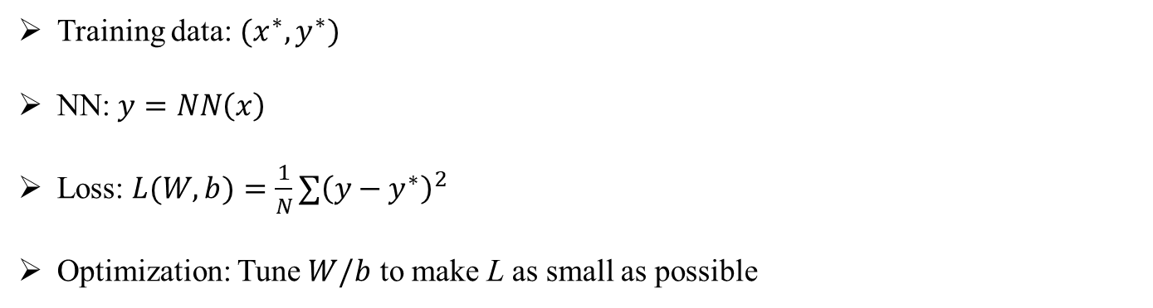

Optimization – Gradient descent algorithm
Training data: $(x^{∗},y^{∗})$
NN: $y=NN\left(x\right)$
Loss: $L(W,b)=\frac{1}{N}{∑\left(y−y^{∗}\right)}^{2}$
Optimization: Tune $W/b$ to make L as small as possible
$$L(W,b)≥0$$
$$∂_{W}L=0$$
W/b -> very high-dimensional
Local minima

Slide 13


Optimization – Gradient descent algorithm
$w_{n}=w_{n−1}−{ε∇}_{w}L$

Slide 14
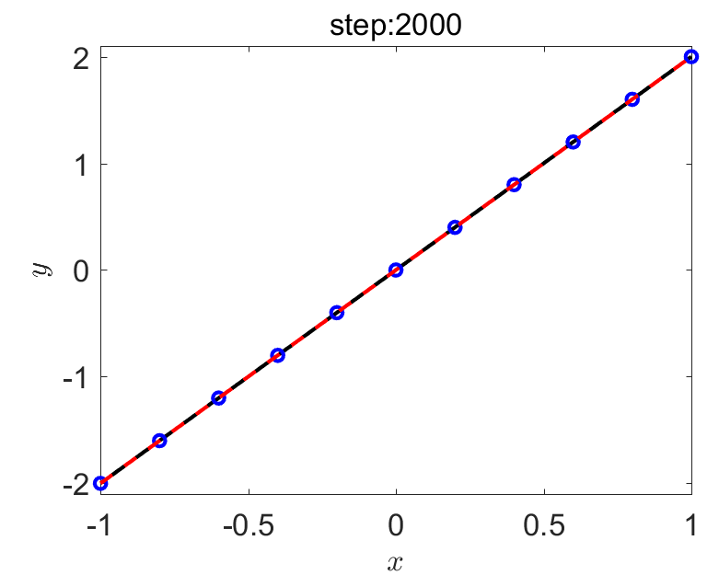
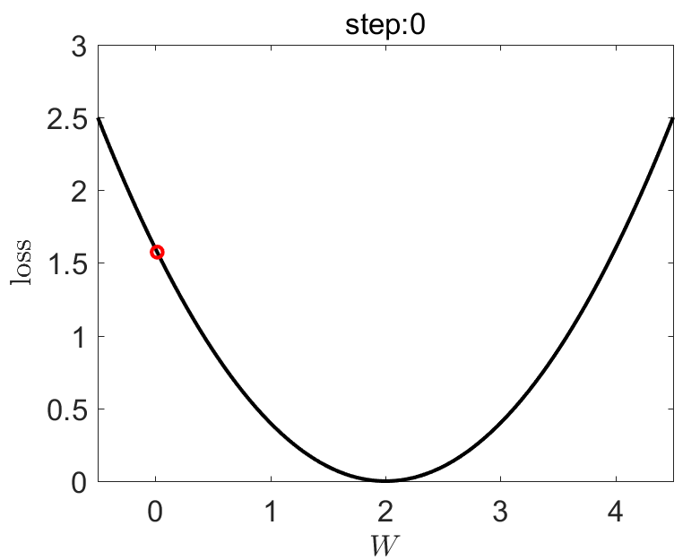
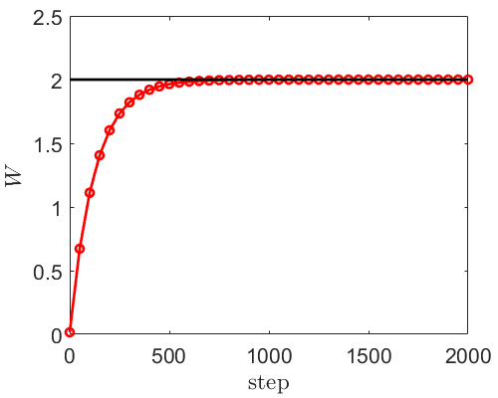

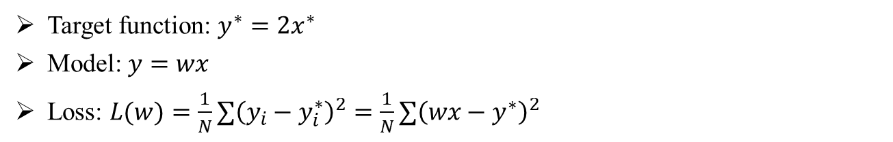
Optimization – Gradient descent algorithm
Target function: $y^{∗}=2x^{∗}$
Model: $y=wx$
Loss: $L(w)={\frac{1}{N}∑\left(y_{i}−y_{i}^{∗}\right)}^{2}=\frac{1}{N}{∑\left(wx−y^{∗}\right)}^{2}$
$$w_{n}=w_{n−1}−{ε∇}_{w}L,$$
$w_{0}=0, ε={10}^{−2}$

Slide 15

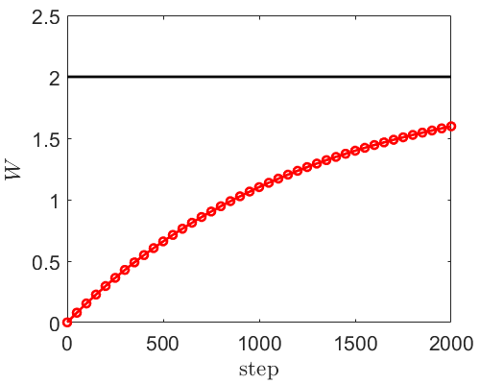

Optimization – Gradient descent algorithm
Target function: $y^{∗}=2x^{∗}$
Model: $y=wx$
Loss: $L(w)={\frac{1}{N}∑\left(y_{i}−y_{i}^{∗}\right)}^{2}=\frac{1}{N}{∑\left(wx−y^{∗}\right)}^{2}$
$$w_{n}=w_{n−1}−{ε∇}_{w}L,$$
$w_{0}=0, ε={10}^{−3}$

Slide 16
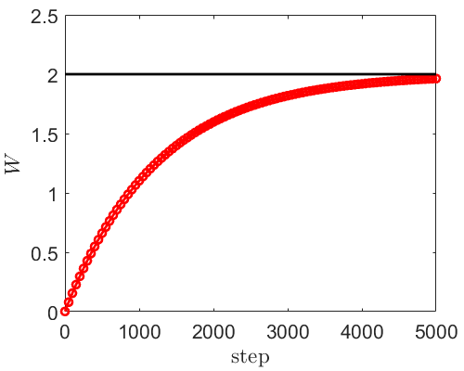

Optimization – Gradient descent algorithm
Target function: $y^{∗}=2x^{∗}$
Model: $y=wx$
Loss: $L(w)={\frac{1}{N}∑\left(y_{i}−y_{i}^{∗}\right)}^{2}=\frac{1}{N}{∑\left(wx−y^{∗}\right)}^{2}$
$$w_{n}=w_{n−1}−{ε∇}_{w}L,$$
$w_{0}=0, ε={10}^{−3}$

Slide 17
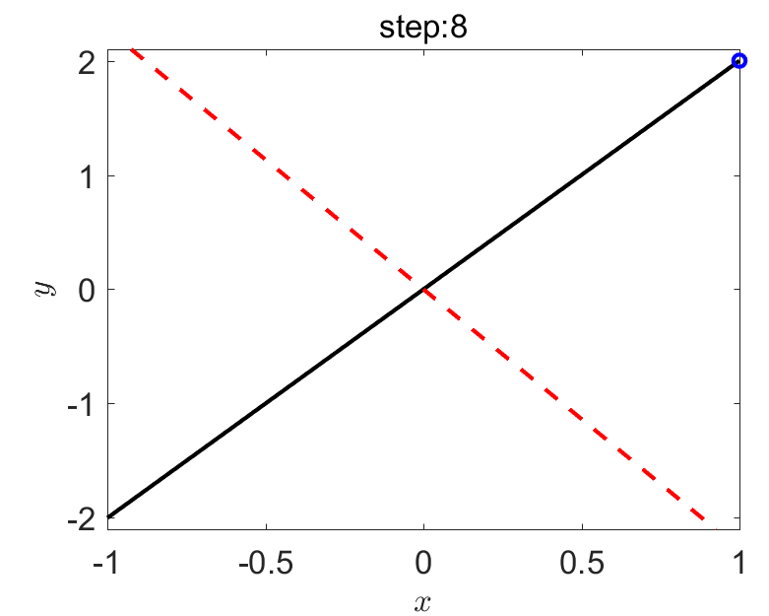
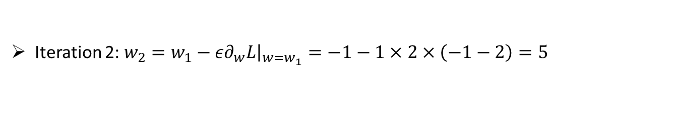
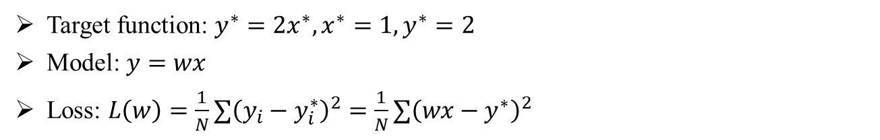
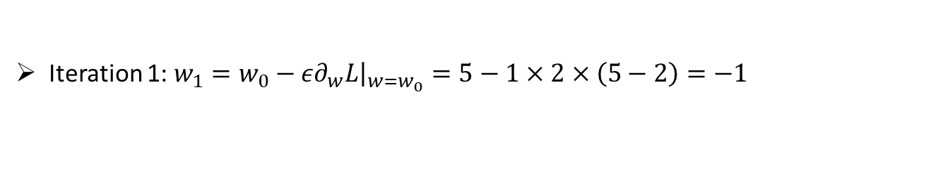

Optimization – Gradient descent algorithm
Target function: $y^{∗}=2x^{∗},x^{∗}=1,y^{∗}=2$
Model: $y=wx$
Loss: $L\left(w\right)={\frac{1}{N}∑\left(y_{i}−y_{i}^{∗}\right)}^{2}=\frac{1}{N}{∑\left(wx−y^{∗}\right)}^{2}$
$$L\left(w\right)={\left(w−2\right)}^{2}, ∂_{w}L=2(w−2)$$
$$w_{n}=w_{n−1}−{ε∇}_{w}L,$$
$$w_{0}=5, ε=1$$
Iteration 1: $w_{1}=w_{0}−{ε∂}_{w}L{\left.​\right|}_{w=w_{0}}=5−1×2×\left(5−2\right)=−1$
Iteration 2: $w_{2}=w_{1}−{ε∂}_{w}L{\left.​\right|}_{w=w_{1}}=−1−1×2×\left(−1−2\right)=5$
Iteration 3: $w_{3}=−1$
Iteration 4: $w_{4}=5$
…

Slide 18
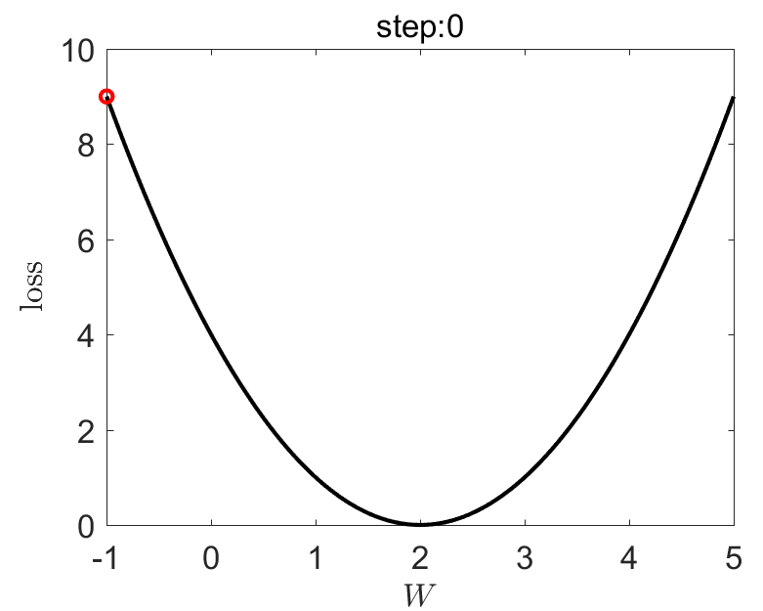
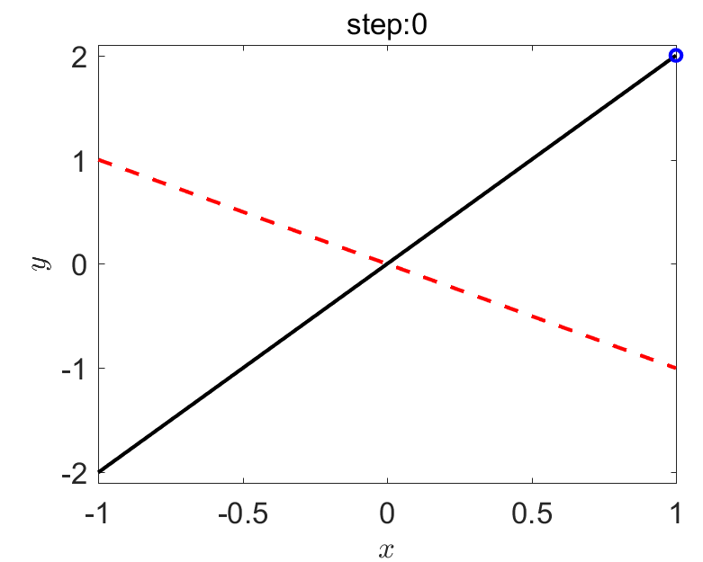
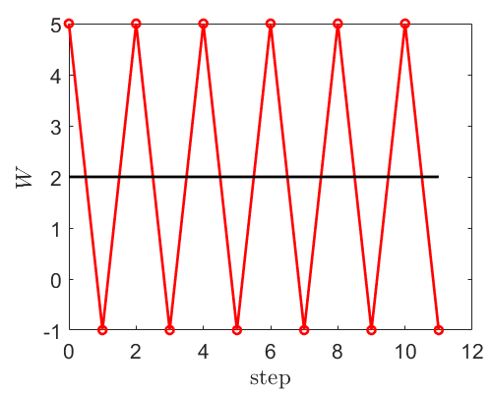
Optimization – Gradient descent algorithm

Slide 19
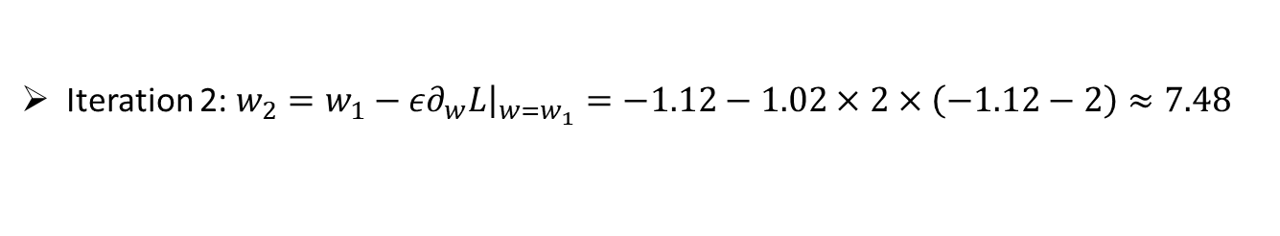
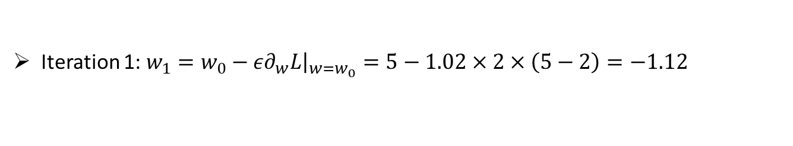

Optimization – Gradient descent algorithm
Target function: $y^{∗}=2x^{∗},x^{∗}=1,y^{∗}=2$
Model: $y=wx$
Loss: $L\left(w\right)={\frac{1}{N}∑\left(y_{i}−y_{i}^{∗}\right)}^{2}=\frac{1}{N}{∑\left(wx−y^{∗}\right)}^{2}$
$$L\left(w\right)={\left(w−2\right)}^{2}, ∂_{w}L=2(w−2)$$
$$w_{n}=w_{n−1}−{ε∇}_{w}L,$$
$$w_{0}=5, ε=1.02$$
Iteration 1: $w_{1}=w_{0}−{ε∂}_{w}L{\left.​\right|}_{w=w_{0}}=5−1.02×2×\left(5−2\right)=−1.12$
Iteration 2: $w_{2}=w_{1}−{ε∂}_{w}L{\left.​\right|}_{w=w_{1}}=−1.12−1.02×2×\left(−1.12−2\right)≈7.48$
Iteration 3: $w_{3}≈−3.70$
…

Slide 20
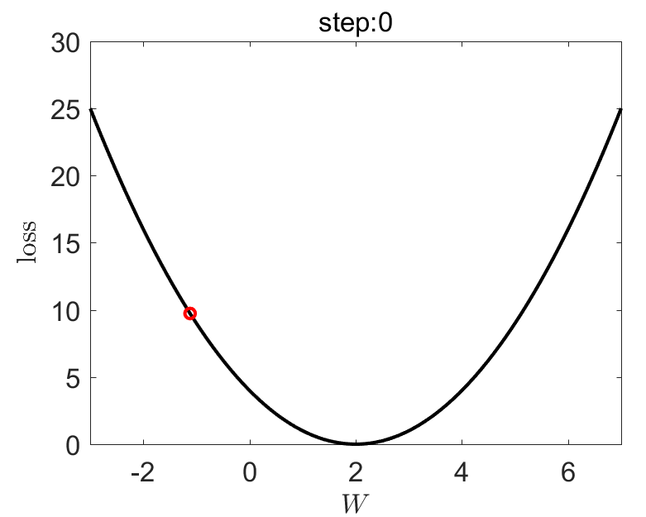
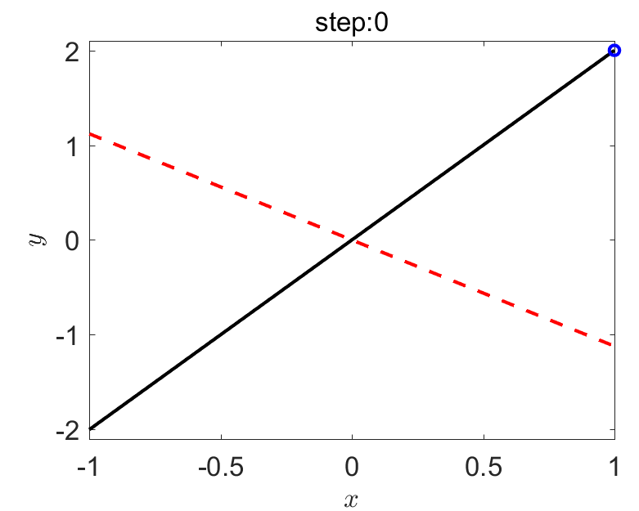
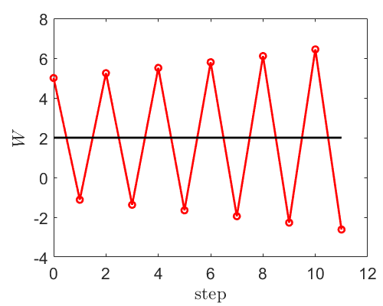
Optimization – Gradient descent algorithm

Slide 21
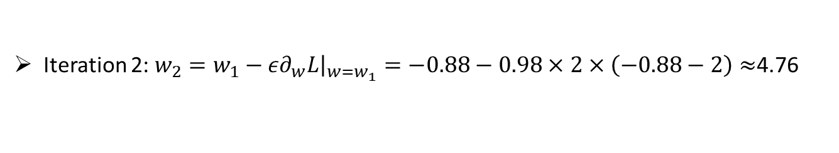
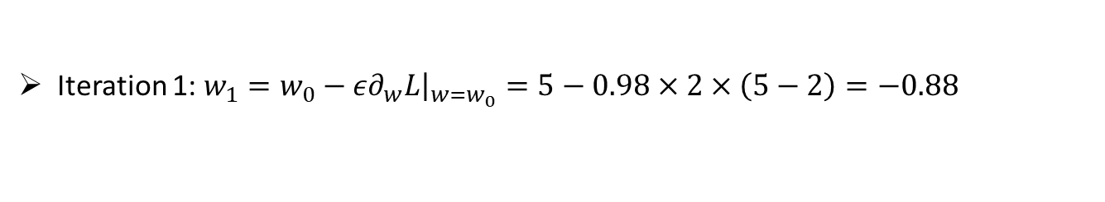

Optimization – Gradient descent algorithm
Target function: $y^{∗}=2x^{∗},x^{∗}=1,y^{∗}=2$
Model: $y=wx$
Loss: $L\left(w\right)={\frac{1}{N}∑\left(y_{i}−y_{i}^{∗}\right)}^{2}=\frac{1}{N}{∑\left(wx−y^{∗}\right)}^{2}$
$$L\left(w\right)={\left(w−2\right)}^{2}, ∂_{w}L=2(w−2)$$
$$w_{n}=w_{n−1}−{ε∇}_{w}L,$$
$$w_{0}=5, ε=0.98$$
Iteration 1: $w_{1}=w_{0}−{ε∂}_{w}L{\left.​\right|}_{w=w_{0}}=5−0.98×2×\left(5−2\right)=−0.88$
Iteration 2: $w_{2}=w_{1}−{ε∂}_{w}L{\left.​\right|}_{w=w_{1}}=−0.88−0.98×2×\left(−0.88−2\right)≈$4.76
Iteration 3: $w_{3}≈−0.65$
…

Slide 22
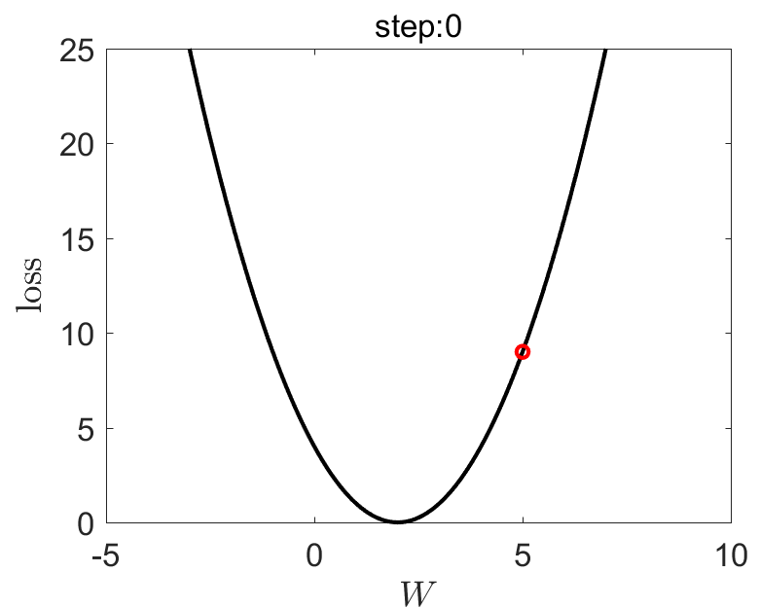
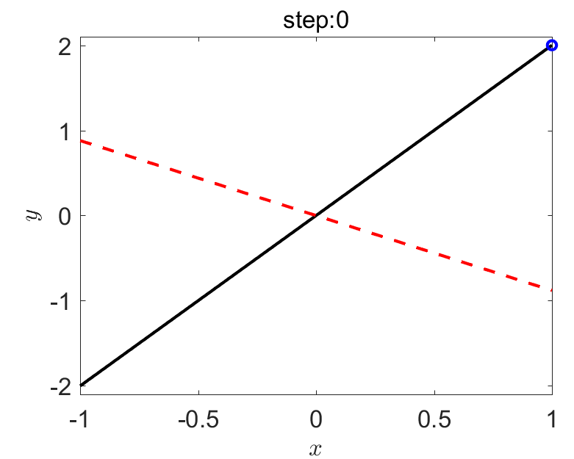
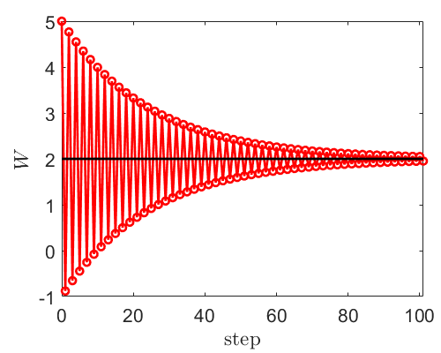
Optimization – Gradient descent algorithm

Slide 23
Optimization – Gradient descent algorithm
Initialization of model parameters
Learning rate

Slide 24
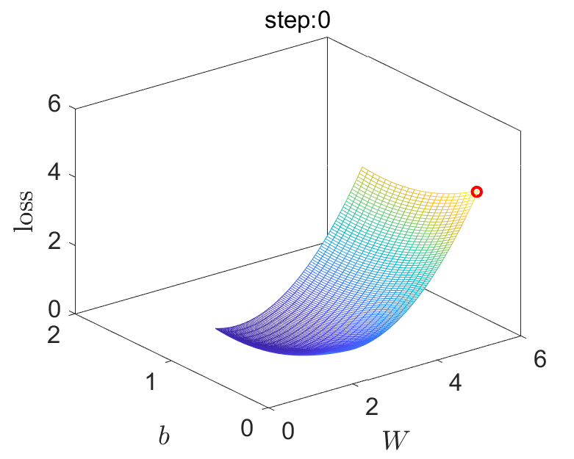
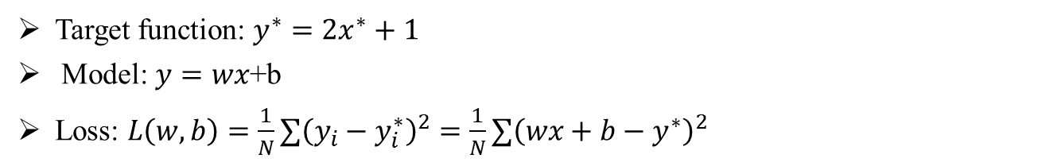
Optimization – Gradient descent algorithm
Target function: $y^{∗}=2x^{∗}+1$
Model: $y=wx$+b
Loss: $L\left(w,b\right)={\frac{1}{N}∑\left(y_{i}−y_{i}^{∗}\right)}^{2}=\frac{1}{N}{∑\left(wx+b−y^{∗}\right)}^{2}$

Slide 25
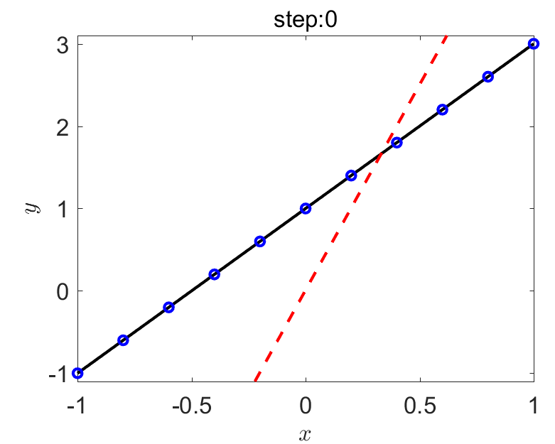

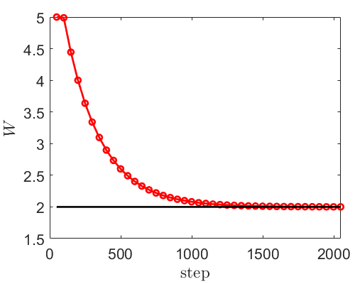


Optimization – Gradient descent algorithm
$$w_{n}=w_{n−1}−{ε∇}_{w}L,$$
$$w_{0}=5, b_{0}=0, ε={10}^{−2}$$

Slide 26
Contents
Deep Neural Networks
Optimization – (Stochastic) Gradient descent algorithm
NN for One-dimensional Function Approximation

Slide 27


Software for AI
Matlab
Julia
Mindspore

Slide 28
Algorithm

Slide 29

Tensorflow: Building a NN

Slide 30

Tensorflow: Loss

Slide 31

Tensorflow: Initialization of NN parameters

Slide 32

Tensorflow: Optimization

Slide 33
Tensorflow: Prediction
feed_dict={x: x_test}

Slide 34





Regression: 1D function approximation
$y=x^{2}$
3 hidden layers with 20 neurons per layer
Activation function: tanh
$$L_{2}=\frac{{∑\left(y_{pred}−y_{ref}\right)}^{2}}{∑{\left(y_{ref}\right)}^{2}}$$

Slide 35


Regression: 1D function approximation
3 hidden layers with 20 neurons per layer
Activation function: sigmoid

Slide 36

Regression: 1D function approximation
3 hidden layers with 20 neurons per layer
Activation function: ReLU

Slide 37

Thank you for your attention!

